Slide 1
GENERATIVE AI
WEEK-1
Asst.Prof.Dr.Murat ŞİMŞEK

Slide 2
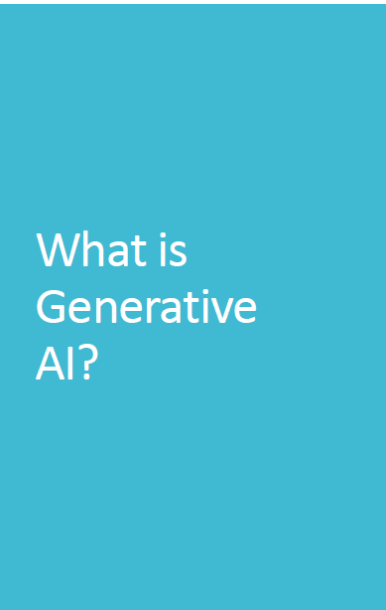
What is Generative AI ?
Generative Artificial Intelligence (GenAI) represents a specialized subset of artificial intelligence systems that can create, generate, or produce novel content by learning patterns and structures from existing data.
Üretken Yapay Zeka (GenAI), mevcut verilerden kalıpları ve yapıları öğrenerek yeni içerikler yaratabilen, üretebilen veya oluşturabilen yapay zeka sistemlerinin özel bir alt kümesini temsil eder.

Slide 3
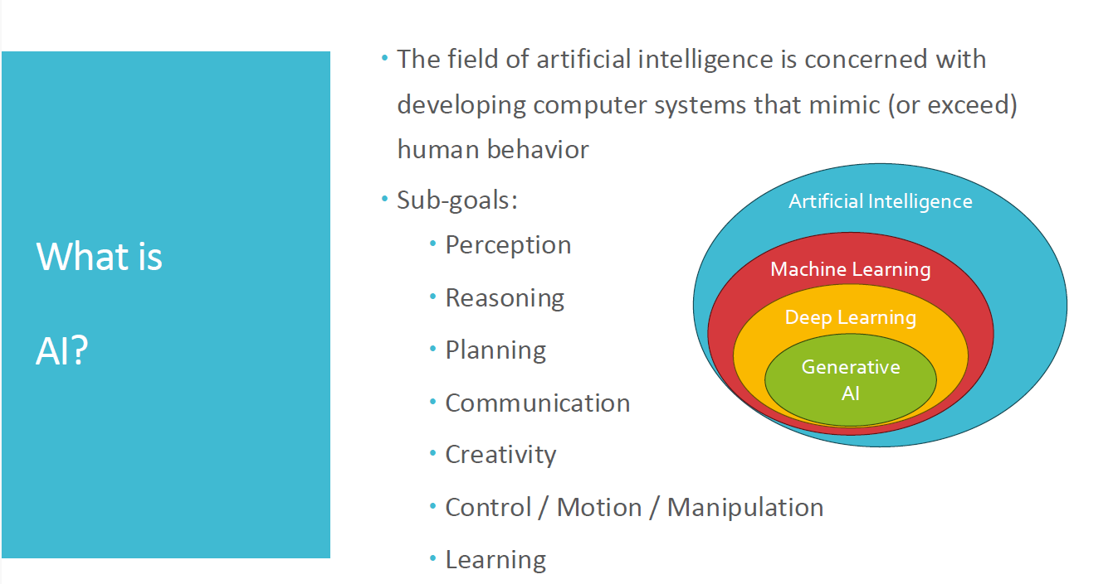

Slide 4
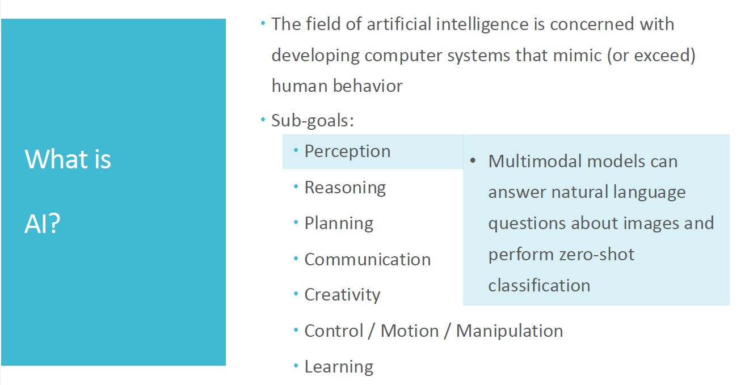

Slide 5
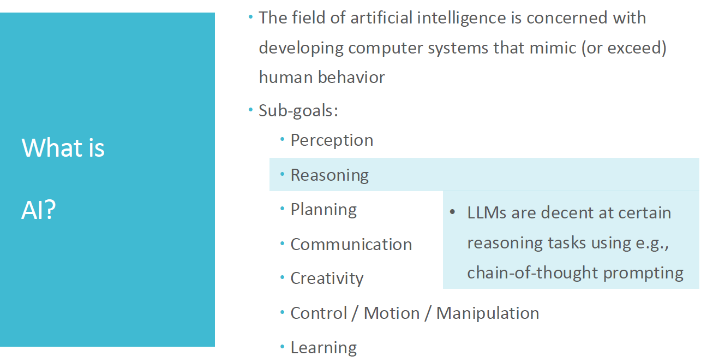

Slide 6
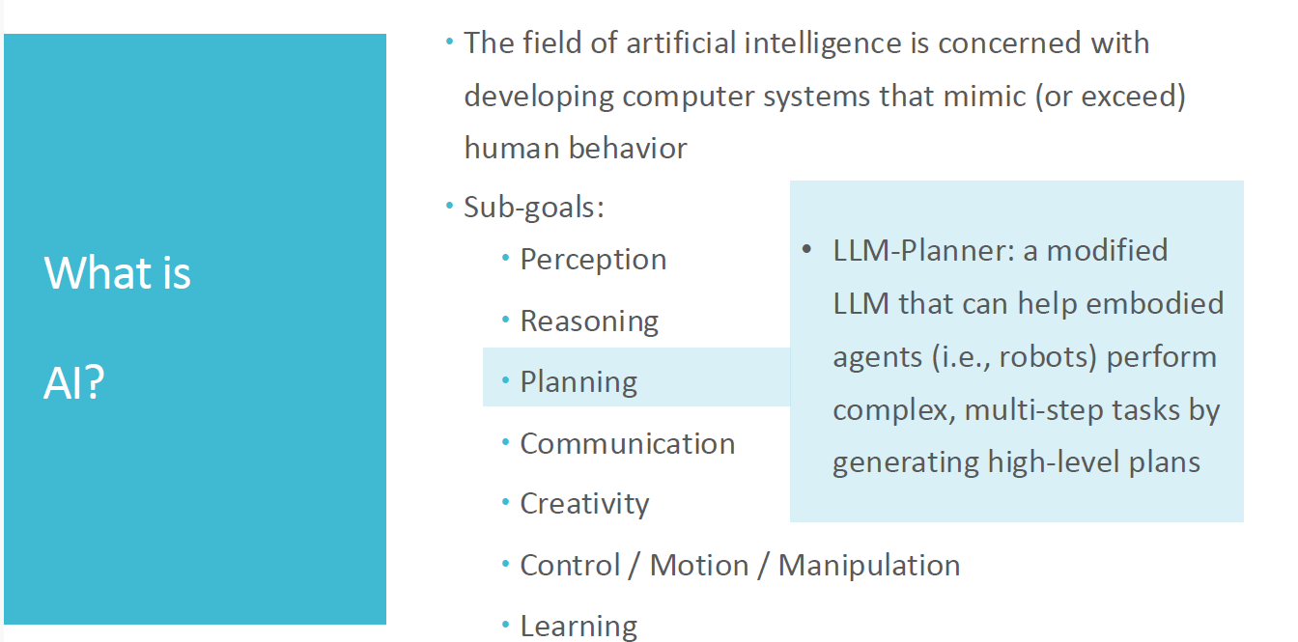

Slide 7
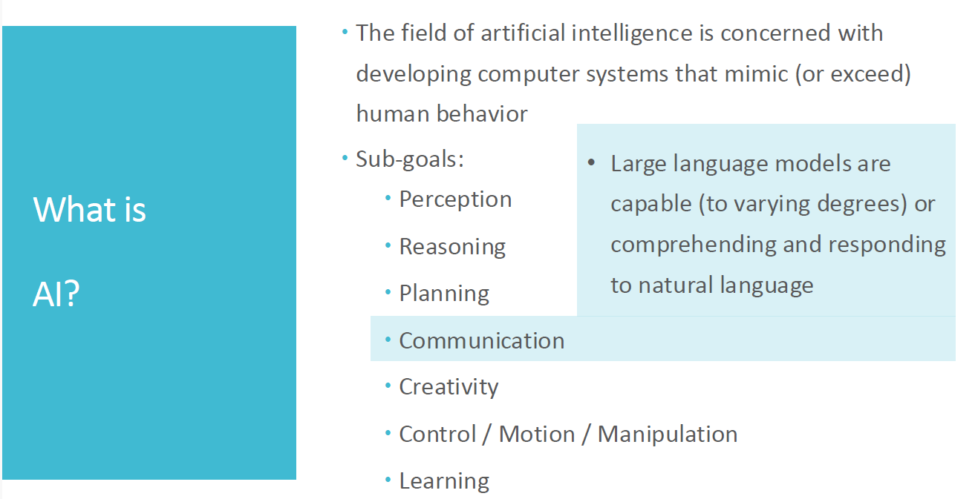

Slide 8
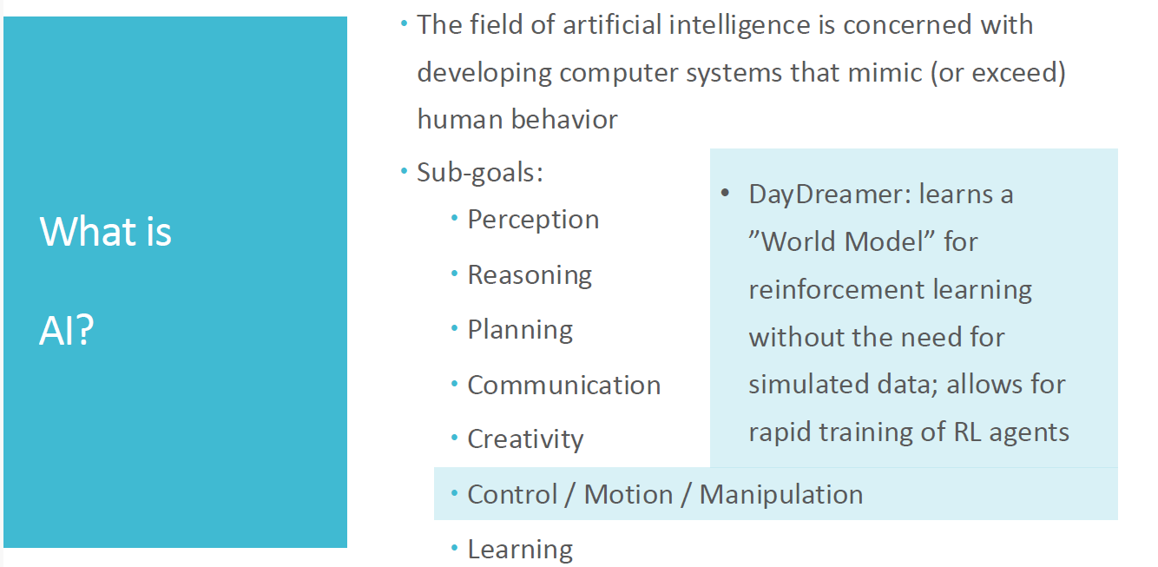

Slide 9
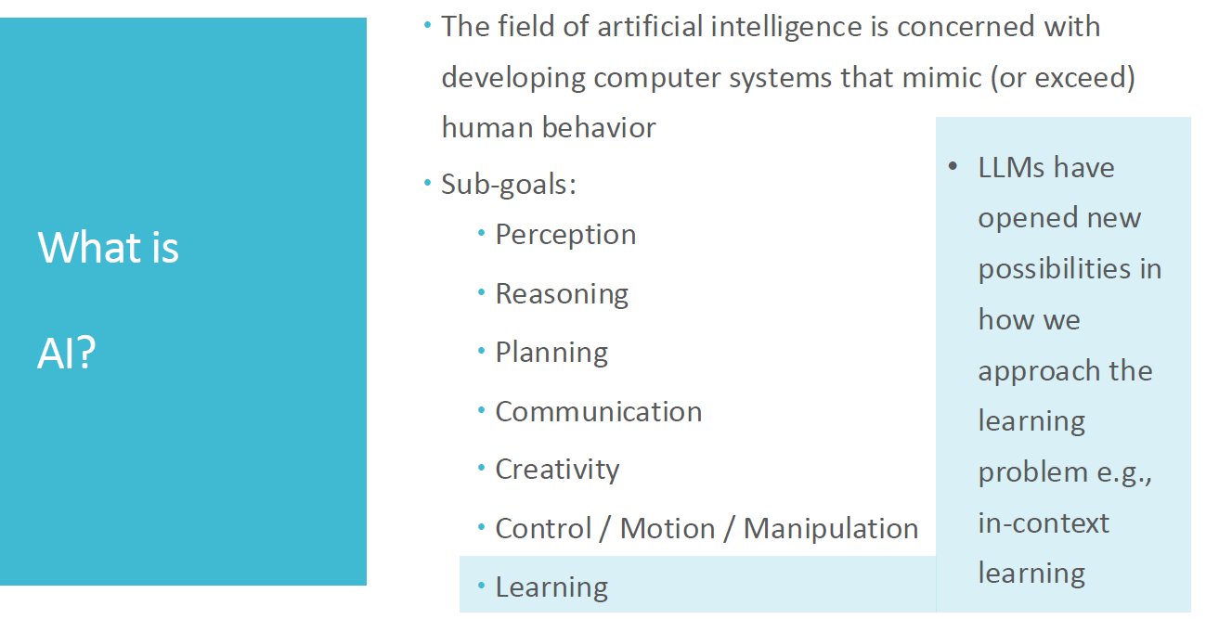

Slide 10
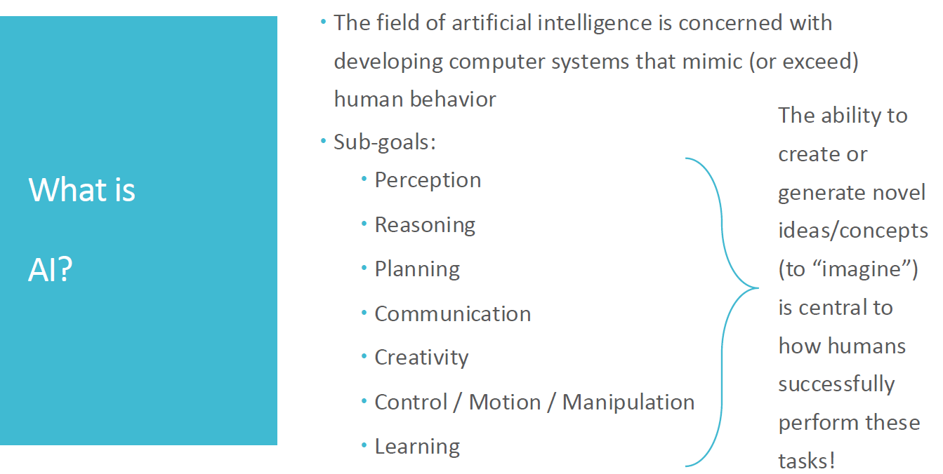

Slide 11
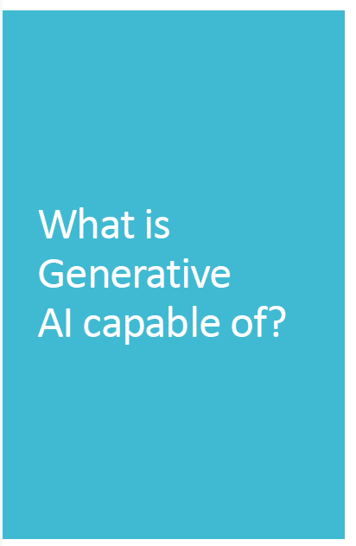
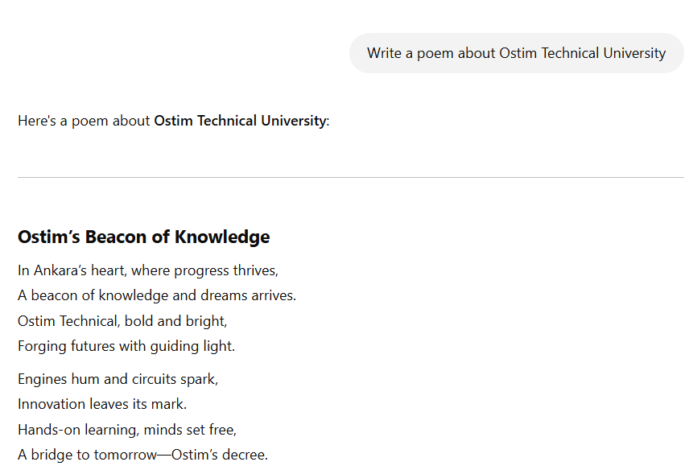

Slide 13
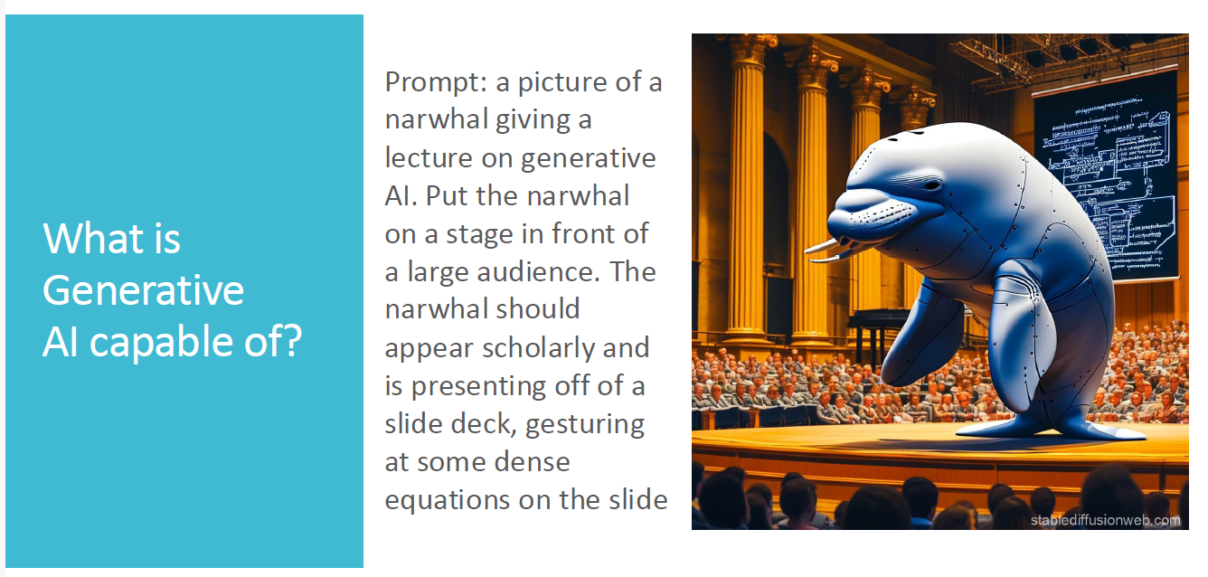

Slide 14
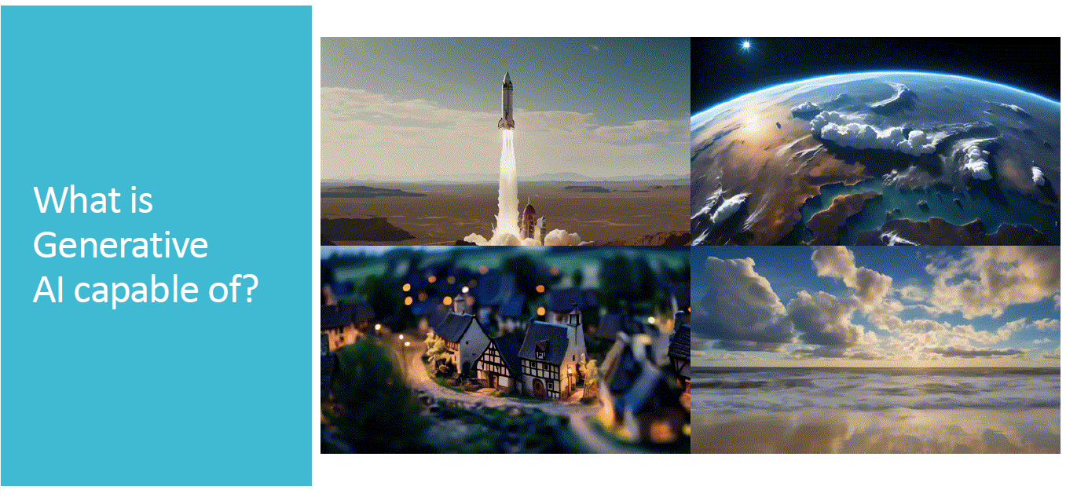

Slide 15
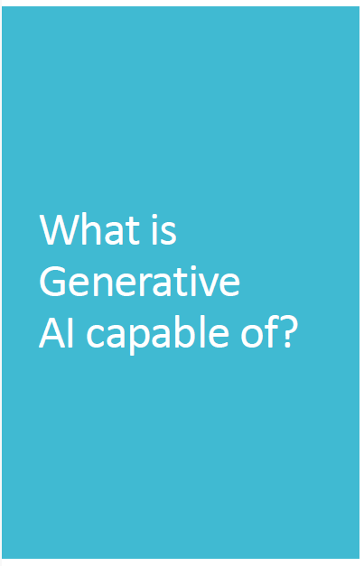

[Verse] In Ankara’s heart where progress thrives
A school of dreams where vision arrives
Ostim Technical standin' tall
Future's calling breaking the wall
[Verse 2] Forging futures with guiding light Through the darkness we take the flight
Ideas soaring in the air Innovation everywhere
[Chorus] Ostim Technical here we rise Crafting stories under the skies
Every moment we defy
Chasing dreams up so high

Slide 16
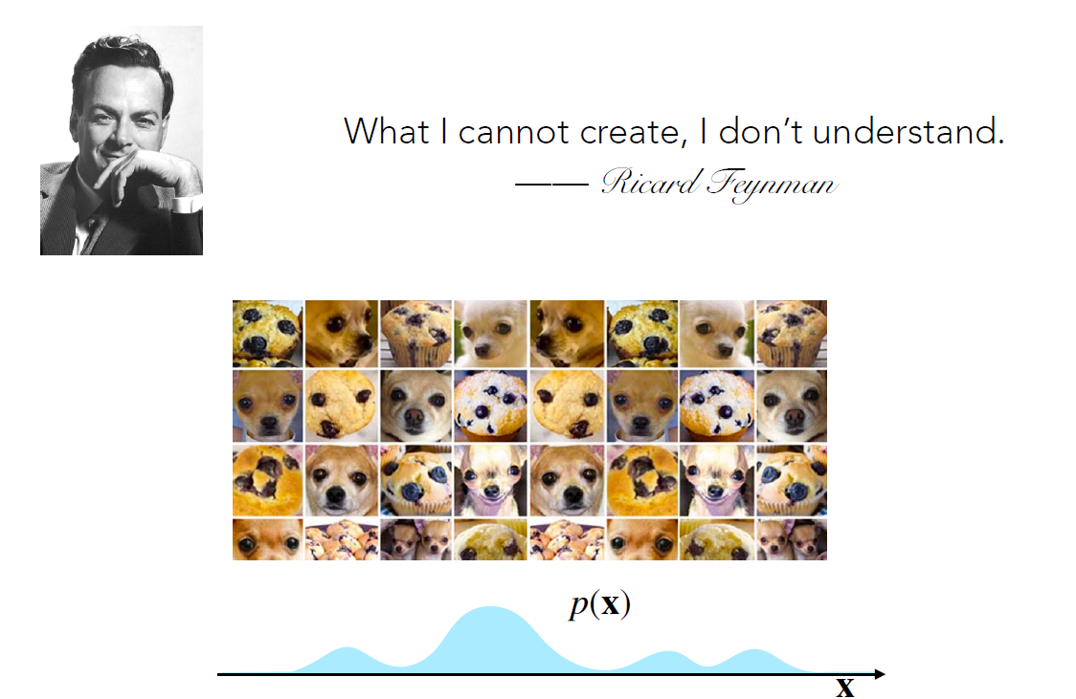

Slide 17
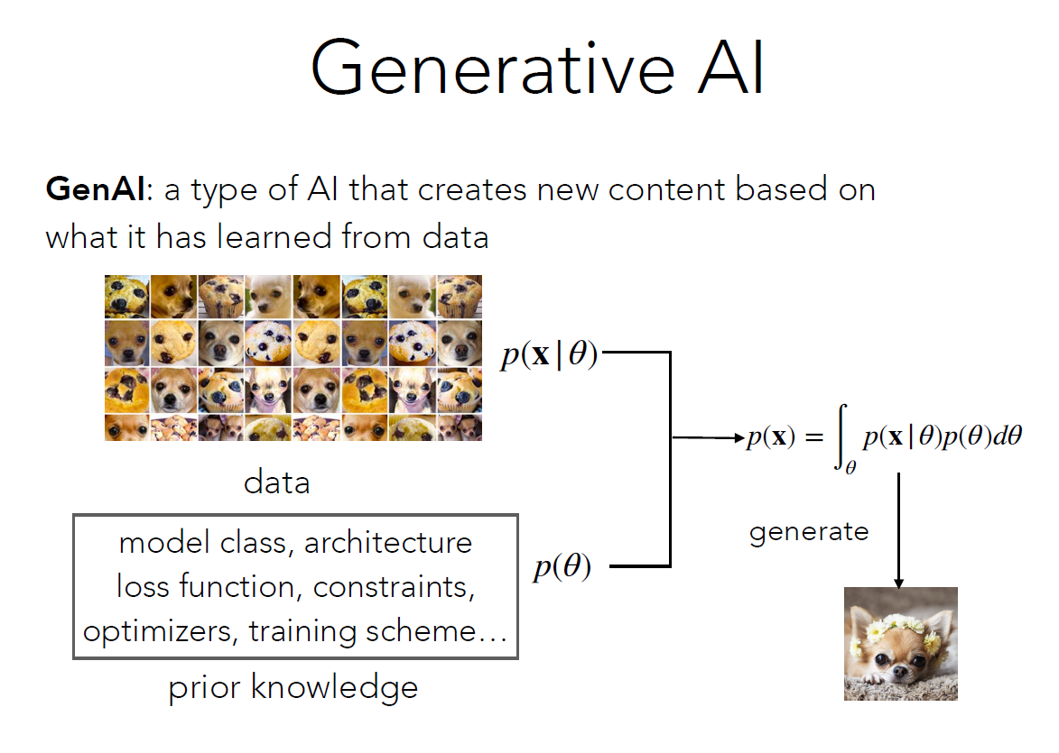
Notes:
The top-left part of the slide shows a grid of images, which represents the dataset the AI model is trained on.
These images seem to contain dogs mixed with other objects (such as cookies or textures), indicating that the AI is trained on a variety of inputs to understand their patterns.
The bottom-left box labeled "prior knowledge" refers to the essential components required to train a generative AI model, including:
Model class (e.g., Variational Autoencoders, GANs, or Transformers)
Architecture (e.g., convolutional networks for image generation)
Loss function (e.g., adversarial loss, likelihood estimation)
Constraints and regularization (to prevent overfitting)
Optimizers (e.g., Adam optimizer)
Training scheme (e.g., supervised or unsupervised learning)
This prior knowledge guides the AI in learning from data and generating realistic outputs.
The core mathematical concept behind generative models is the probability distribution of data.The two key probability functions in the image:
p(x∣θ): This represents the likelihood of data x given the model parameters θ It describes how well the model fits the data.
p(θ): This represents the prior distribution over model parameters, ensuring that the model follows a structured approach.
The equation at the center-right of the slide:
p(x)=∫θ​p(x∣θ)p(θ)dθdescribes how the model integrates over all possible parameters to estimate the probability distribution of the new data.
Once trained, the model can sample from this learned distribution and create new content.

Slide 18
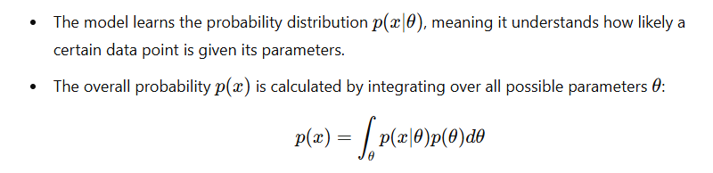
Notes:
Generative AI (GenAI) is a type of artificial intelligence that learns from data and generates new content based on that learning. Instead of simply recognizing patterns, it creates entirely new examples that resemble the training data.
Üretken Yapay Zekâ (GenAI), verilerden öğrenen ve bu öğrendiklerine dayanarak yeni içerik üreten bir yapay zekâ türüdür. Sadece kalıpları tanımakla kalmaz, aynı zamanda eğitim aldığı veriye benzeyen tamamen yeni örnekler oluşturur.
How Does Generative AI Work? / Üretken Yapay Zekâ Nasıl Çalışır?
Data Collection (Veri Toplama):
The model is trained on a dataset, which consists of different images, texts, or other forms of data.
In the image, we see a dataset containing pictures of dogs and muffins.
Model, farklı resimler, metinler veya diğer veri türlerinden oluşan bir veri kümesi ile eğitilir.
Görselde, köpekler ve muffinlerden oluşan bir veri kümesi görüyoruz.
Prior Knowledge (Ön Bilgi):
The model uses prior knowledge, such as model architecture, loss function, constraints, optimizers, and training schemes.
This prior knowledge helps the AI learn how to generate realistic outputs.
Model, model yapısı, kayıp fonksiyonu, kısıtlamalar, optimize ediciler ve eğitim şeması gibi ön bilgileri kullanır.
Bu ön bilgi, yapay zekânın gerçekçi çıktılar üretmesine yardımcı olur.

Slide 19
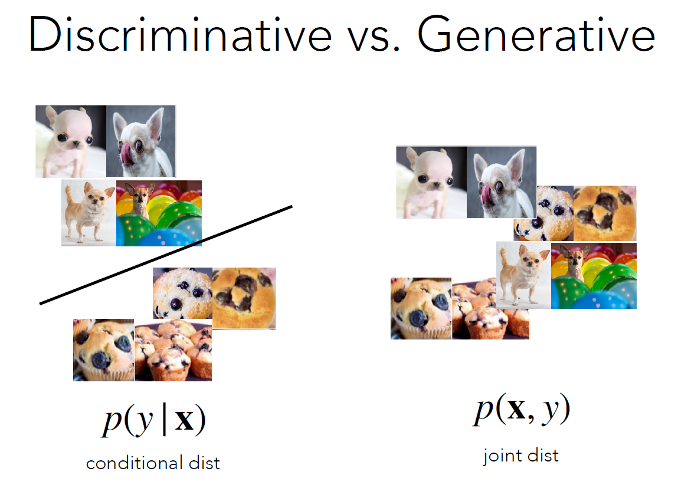
In AI, models can be categorized as either discriminative or generative. These two approaches differ in how they learn from data and make predictions.

Slide 21
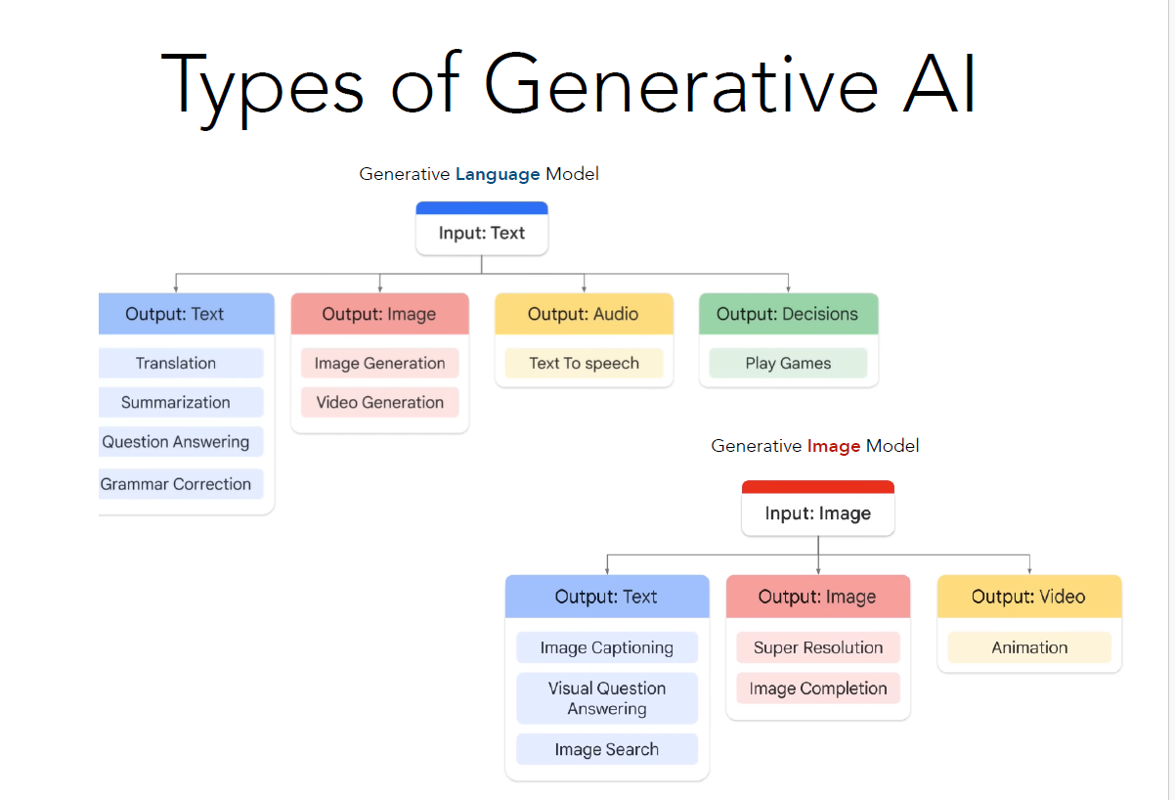

Slide 22
